Slide 1
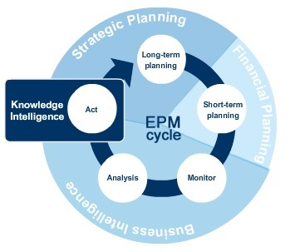

Slide 2
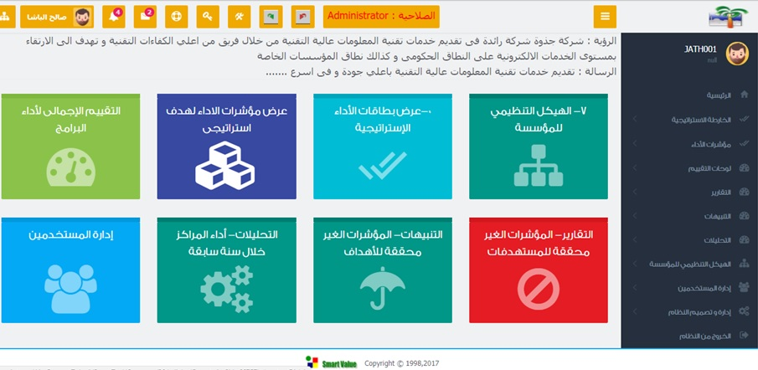

Slide 3
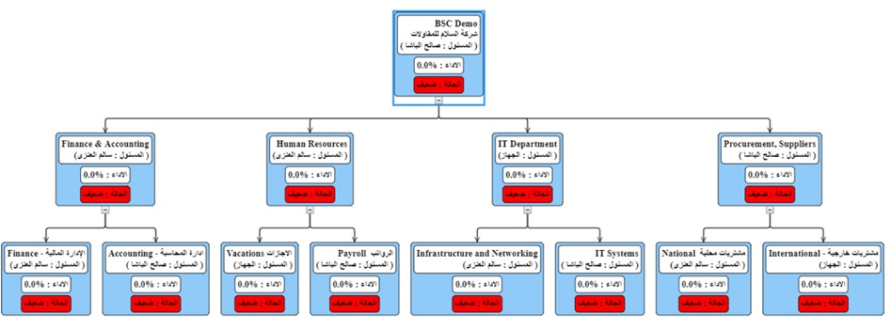
Organization Chart :
Jathwa EPM System Provide a very flexible graphical management and presentation interface for building and managing Your Organization charts

Slide 4
